Slide 1
Introduction to Routing and Packet Forwarding
Routing Protocols and Concepts – Chapter 1

Slide 2
Objectives
Identify a router as a computer with an OS and hardware designed for the routing process.
Demonstrate the ability to configure devices and apply addresses.
Describe the structure of a routing table.
Describe how a router determines a path and switches packets

Slide 3
Router as a Computer
Describe the basic purpose of a router
  -Computers that specialize in sending packets over the data network. They are responsible for interconnecting networks by selecting the best path for a packet to travel and forwarding packets to their destination
Routers are the network center
  -Routers generally have 2 connections:
    -WAN connection (Connection to ISP)
    -LAN connection

Slide 4
Routers as a Network Centre
Each network that a router connects to typically requires a separate interface.
These interfaces are used to connect a combination of both Local Area Networks (LANs) and Wide Area Networks (WANs).
LANs are commonly Ethernet networks that contain devices such as PCs, printers, and servers. WANs are used to connect networks over a large geographical area.
For example, a WAN connection is commonly used to connect a LAN to the Internet Service Provider (ISP) network.

Slide 5
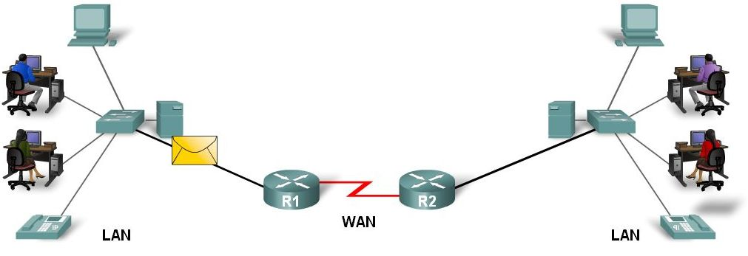
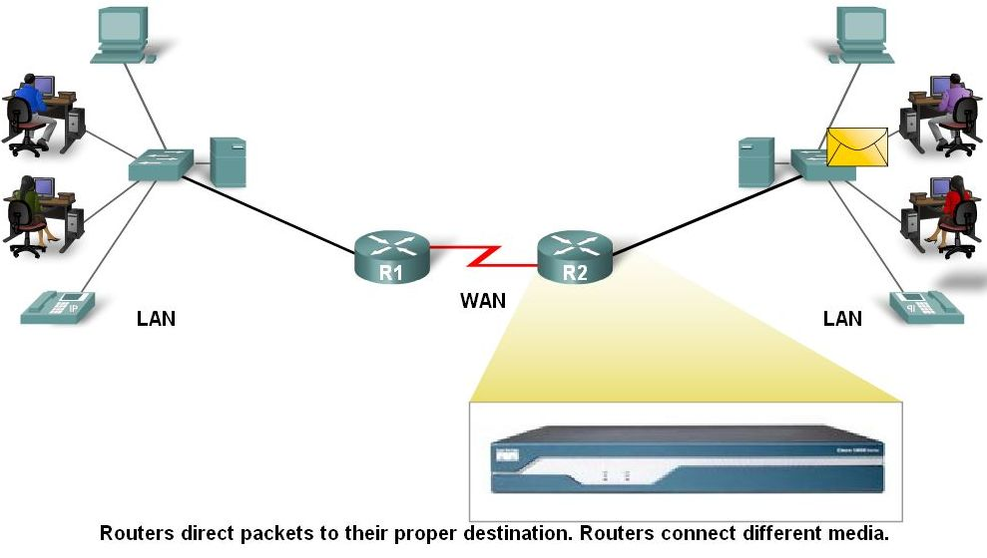
Router as a Computer
Data is sent in form of packets between 2 end devices
Routers are used to direct packet to its destination

Slide 6
Routers and Best Path
The primary responsibility of a router is to direct packets destined for local and remote networks by:
Determining the best path to send packets
Forwarding packets toward their destination
The router uses its routing table to determine the best path to forward the packet.
When the router receives a packet, it examines its destination IP address and searches for the best match with a network address in the router's routing table.
The routing table also includes the interface to be used to forward the packet.
Once a match is found, the router encapsulates the IP packet into the data link frame of the outgoing or exit interface, and the packet is then forwarded toward its destination.

Slide 7
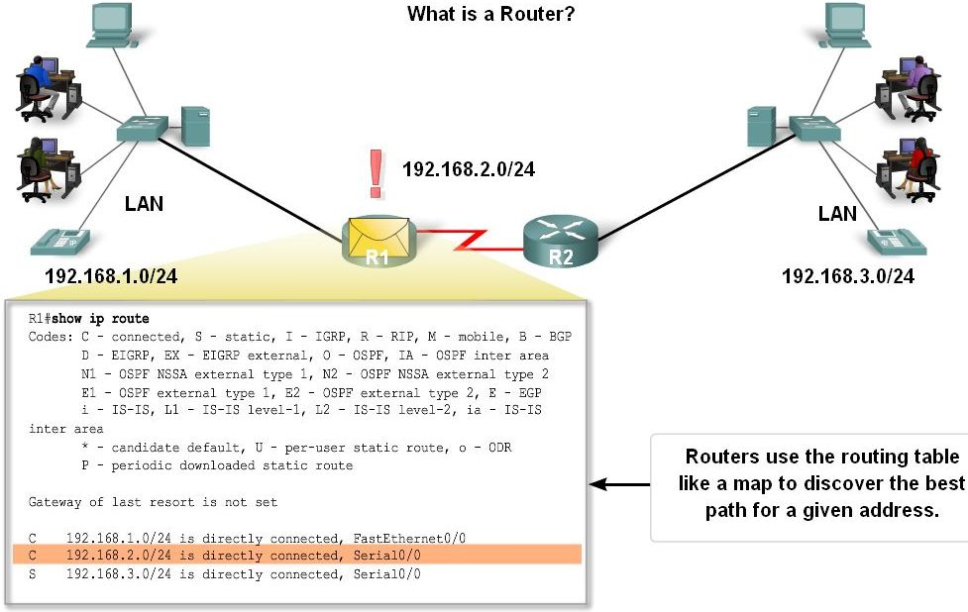
Router as a Computer
Routers examine a packet’s destination IP address and determine the best path by enlisting the aid of a routing table

Slide 8
Role of a Router
In the figure, we can follow a packet from the source PC to the destination PC.
Notice that it is the responsibility of the router to find the destination network in its routing table and forward the packet on toward its destination.
In this example, router R1 receives the packet encapsulated in an Ethernet frame.
After decapsulating the packet, R1 uses the destination IP address of the packet to search its routing table for a matching network address.
After a destination network address is found in the routing table, R1 encapsulates the packet inside a PPP frame and forwards the packet to R2. A similar process is performed by R2.

Slide 9
Router as a Computer
Router components and their functions”
  CPU - Executes operating system instructions
  Random access memory (RAM) - Contains the running copy of configuration file. Stores routing table. RAM contents lost when power is off
  Read-only memory (ROM) - Holds diagnostic software used when router is powered up. Stores the router’s bootstrap program.
  Non-volatile RAM (NVRAM) - Stores startup configuration. This may include IP addresses (Routing protocol, Hostname of router)
  Flash memory - Contains the operating system (Cisco IOS)
  Interfaces - There exist multiple physical interfaces that are used to connect network. Examples of interface types:
    -Ethernet / fast Ethernet interfaces
    -Serial interfaces
    -Management interfaces

Slide 10
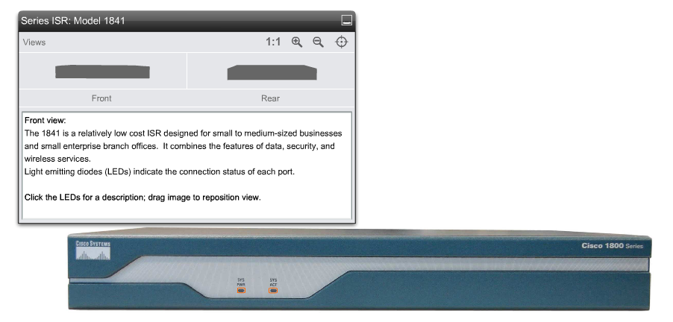
Front View

Slide 11
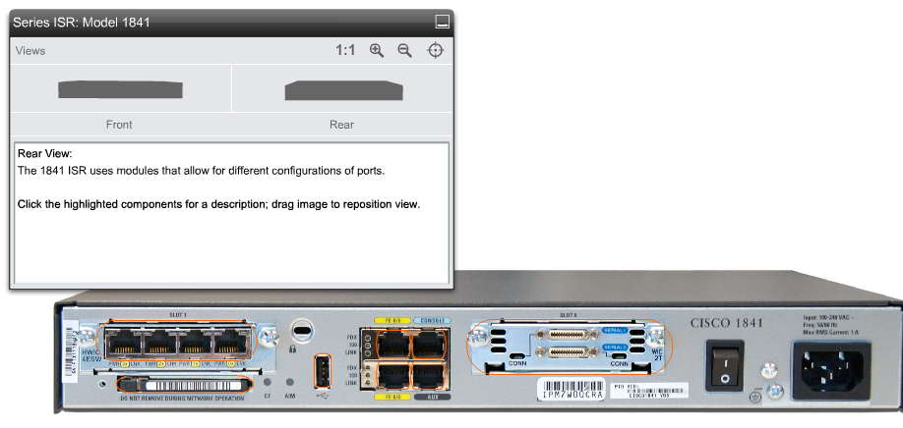
Rear View

Slide 12
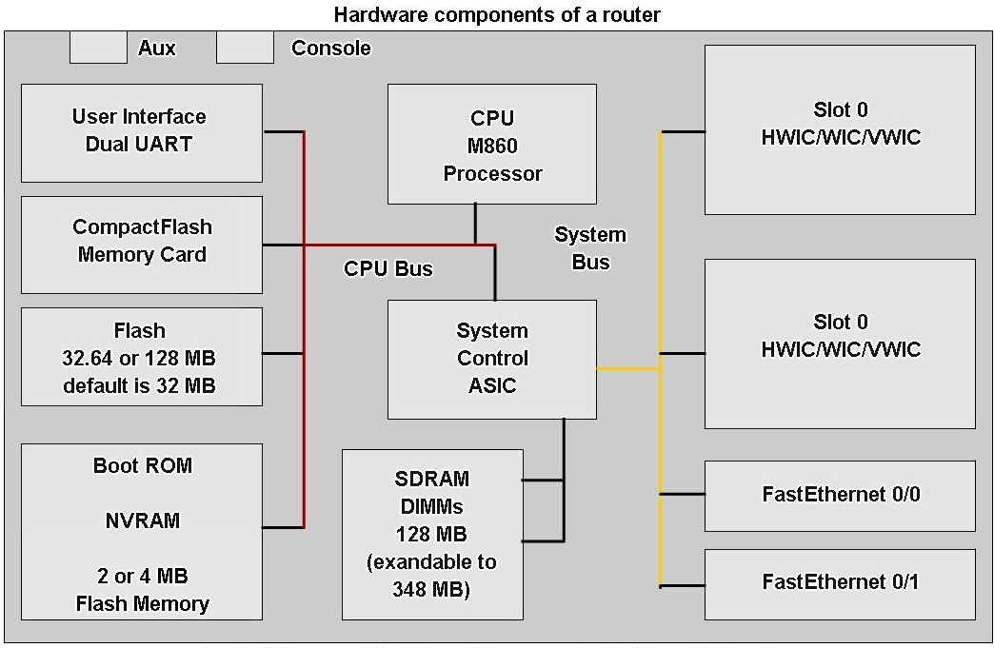
Router as a Computer
Router components

Slide 13
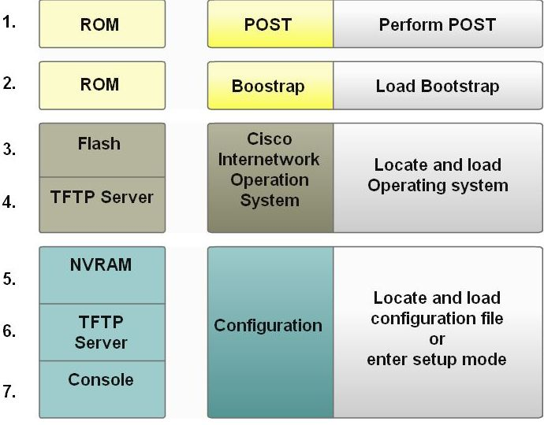
Router as a Computer
Major phases to the router boot-up process
  Test router hardware
    Power-On Self Test (POST)
    Execute bootstrap loader
  Locate & load Cisco IOS software
    -Locate IOS
    -Load IOS
  Locate & load startup configuration file or enter setup mode
    -Bootstrap program looks for configuration file

Slide 14
POST and Bootstrap
1. The Power-On Self Test (POST) is a common process that occurs on almost every computer during bootup.
The POST process is used to test the router hardware. When the router is powered on, software on the ROM chip conducts the POST.
During this self-test, the router executes diagnostics from ROM on several hardware components including the CPU, RAM, and NVRAM.
After the POST has been completed, the router executes the bootstrap program.
2. Loading the Bootstrap Program
After the POST, the bootstrap program is copied from ROM into RAM. Once in RAM, the CPU executes the instructions in the bootstrap program. The main task of the bootstrap program is to locate the Cisco IOS and load it into RAM.

Slide 15
Loading IOS
Locating the Cisco IOS software. The IOS is typically stored in flash memory, but can also be stored in other places such as a TFTP (Trivial File Transfer Protocol) server.
If a full IOS image can not be located, a scaled-down version of the IOS is copied from ROM into RAM. This version of IOS is used to help diagnose any problems and can be used to load a complete version of the IOS into RAM.
Note: A TFTP server is usually used as a backup server for IOS but it can also be used as a central point for storing and loading the IOS. IOS management and using the TFTP server is discussed in a later course.
Loading the IOS. Some of the older Cisco routers ran the IOS directly from flash, but current models copy the IOS into RAM for execution by the CPU.
Note: Once the IOS begins to load, you may see a string of pounds signs (#), as shown in the figure, while the image decompresses.

Slide 16
Locating the Startup Configuration File.
After the IOS is loaded, the bootstrap program searches for the startup configuration file, known as startup-config, in NVRAM.
This file has the previously saved configuration commands and parameters including:
interface addresses
routing information
Passwords
any other configurations saved by the network administrator
If the startup configuration file, startup-config, is located in NVRAM, it is copied into RAM as the running configuration file, running-config.

Slide 17
Executing the Configuration File
If a startup configuration file is found in NVRAM, the IOS loads it into RAM as the running-config and executes the commands in the file, one line at a time. The running-config file contains interface addresses, starts routing processes, configures router passwords and defines other characteristics of the router.
Enter Setup Mode (Optional). If the startup configuration file can not be located, the router prompts the user to enter setup mode. Setup mode is a series of questions prompting the user for basic configuration information. Setup mode is not intended to be used to enter complex router configurations, and it is not commonly used by network administrators.

Slide 18
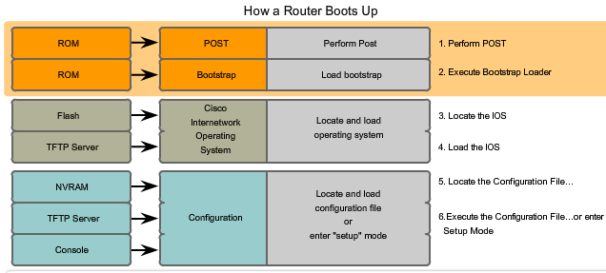
Booting Process

Slide 19
Router as a Computer
Verify the router boot-up process:
  -The show version command is used to view information about the router during the bootup process. Information includes:
    Platform model number
    Image name & IOS version
    Bootstrap version stored in ROM
    Image file name & where it was loaded from
    Number & type of interfaces
    Amount of NVRAM
    Amount of flash
    Configuration register

Slide 20
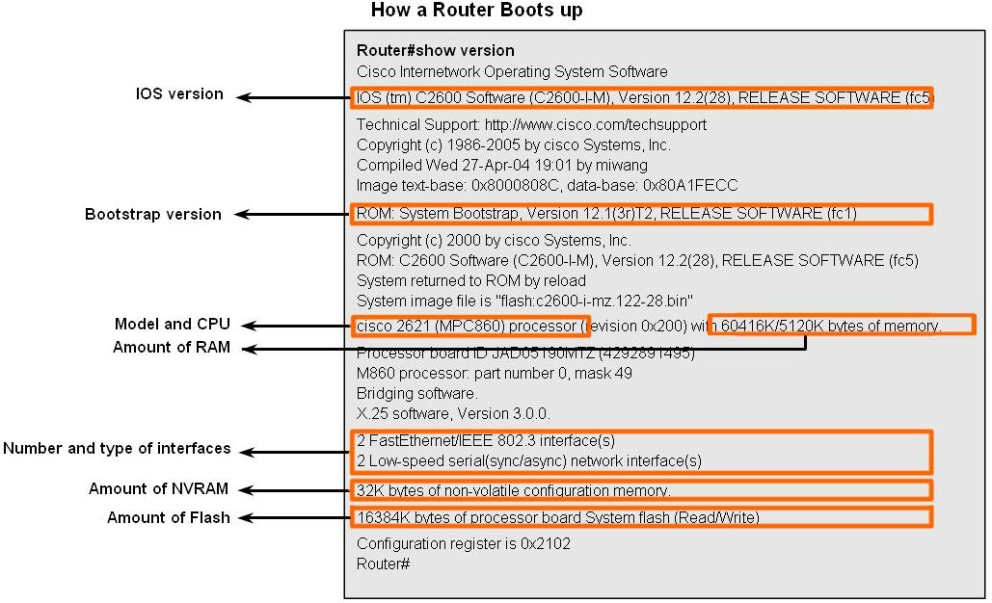
Router as a Computer

Slide 21
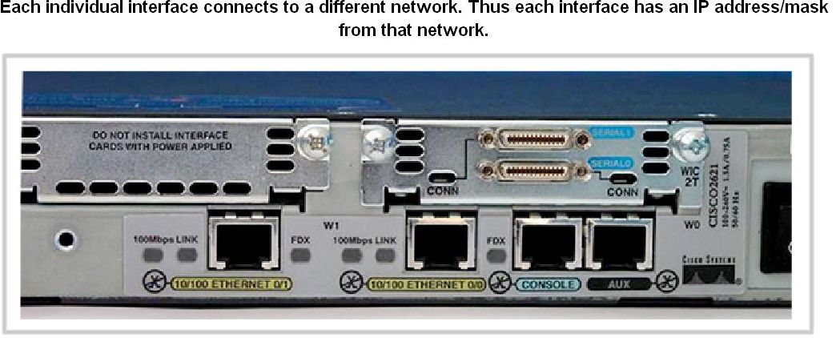
Router as a Computer
Router Interface is a physical connector that enables a router to send or receive packets
Each interface connects to a separate network
Consist of socket or jack found on the outside of a router
Types of router interfaces:
  -Ethernet
  -Fastethernet
  -Serial
  -DSL
  -ISDN
  -Cable

Slide 22
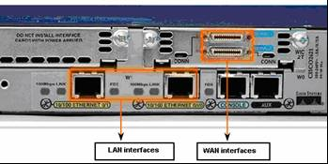
Router as a Computer
Two major groups of Router Interfaces
  LAN Interfaces:
    Are used to connect router to LAN network
    Has a layer 2 MAC address
    Can be assigned a Layer 3 IP address
    Usually consist of an RJ-45 jack
WAN Interfaces
    Are used to connect routers to external networks that interconnect LANs.
    Depending on the WAN technology, a layer 2 address may be used.
    Uses a layer 3 IP address

Slide 23
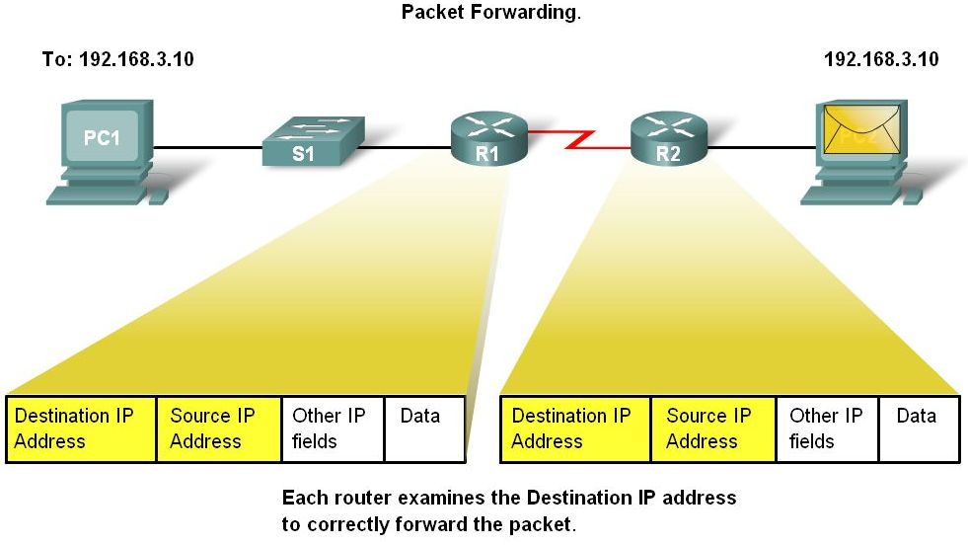
Router as a Computer
Routers and the Network Layer
  Routers use destination IP address to forward packets
  The path a packet takes is determined after a router consults information in the routing table.
  After router determines the best path
  Packet is encapsulated into a frame
  Frame is then placed on network medium in form of Bits

Slide 24
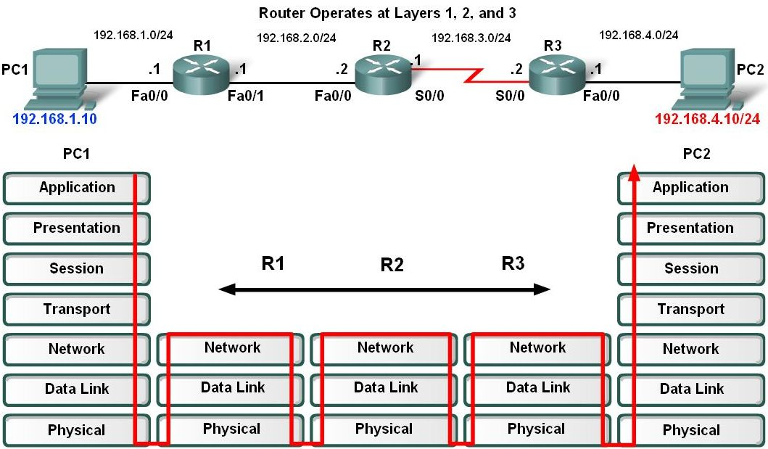
Router as a Computer
Routers Operate at Layers 1, 2 & 3
  Router receives a stream of encoded bits
  Bits are decoded and passed to layer 2
  Router de-encapsulates the frame
  Remaining packet passed up to layer 3
    -Routing decision made at this layer by examining destination IP address
  Packet is then re-encapsulated & sent out outbound interface

Slide 25
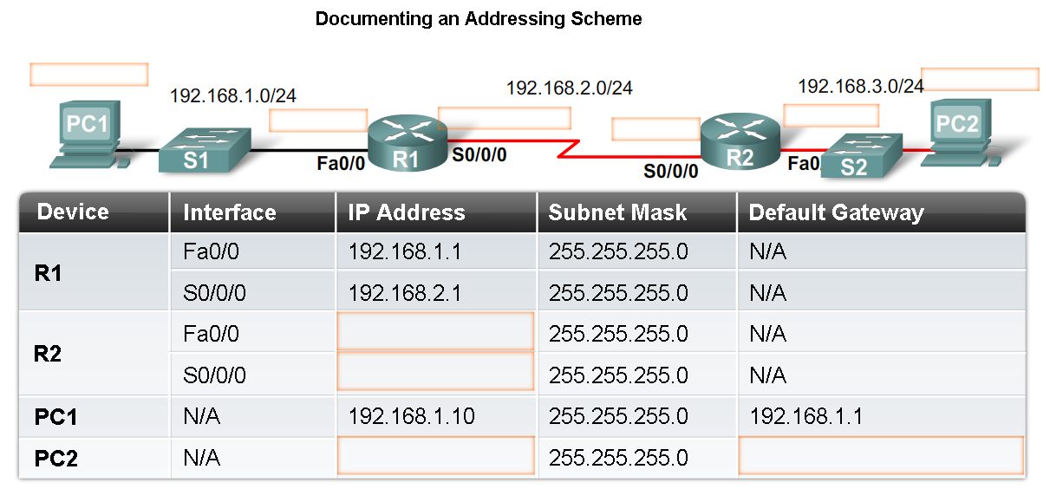
Configure Devices and Apply Addresses
Implementing Basic Addressing Schemes
When designing a new network or mapping an existing network you must provide the following information in the form of a document:
  -Topology drawing that Illustrates physical connectivity
  Address table that provides the following information:
    Device name
    Interfaces used
    IP addresses
    Default gateway

Slide 26
Configure Devices and Apply Addresses
Basic Router Configuration
A basic router configuration should contain the following:
  -Router name - Host name should be unique
  -Banner - At a minimum, banner should warn against unauthorized use
  -Passwords - Use strong passwords
  -Interface configurations - Specify interface type, IP address and subnet mask. Describe purpose of interface. Issue no shutdown command. If DCE serial interface issue clock rate command.
After entering in the basic configuration the following tasks should be completed
  -Verify basic configuration and router operations.
  -Save the changes on a router

Slide 27
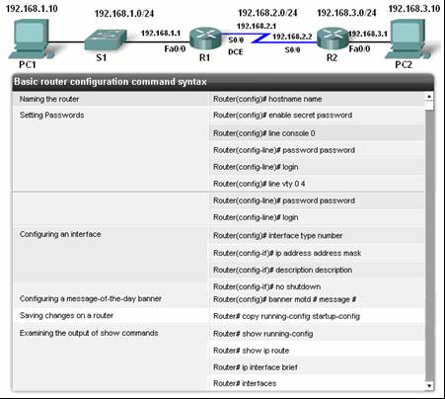
Configure Devices and Apply Addresses

Slide 28
Configure Devices and Apply Addresses
Verify Basic Router Configuration
  -Issue the show running-config command
  -Save the basic router configuration by Issuing the copy running-config startup-config command
  -Additional commands that will enable you to further verify router configuration are:
    Show running-config - Displays configuration currently in RAM
    Show startup-config - Displays configuration file NVRAM
    Show IP route - Displays routing table
    Show interfaces - Displays all interface configurations
    Show IP int brief - Displays abbreviated interface configuration information

Slide 29
Routing Table Structure
Routing Table is stored in ram and contains information about:
  Directly connected networks - this occurs when a device is connected to another router interface
  Remotely connected networks - this is a network that is not directly connected to a particular router
  Detailed information about the networks include source of information, network address & subnet mask, and Ip address of next-hop router
Show ip route command is used to view a routing table

Slide 30
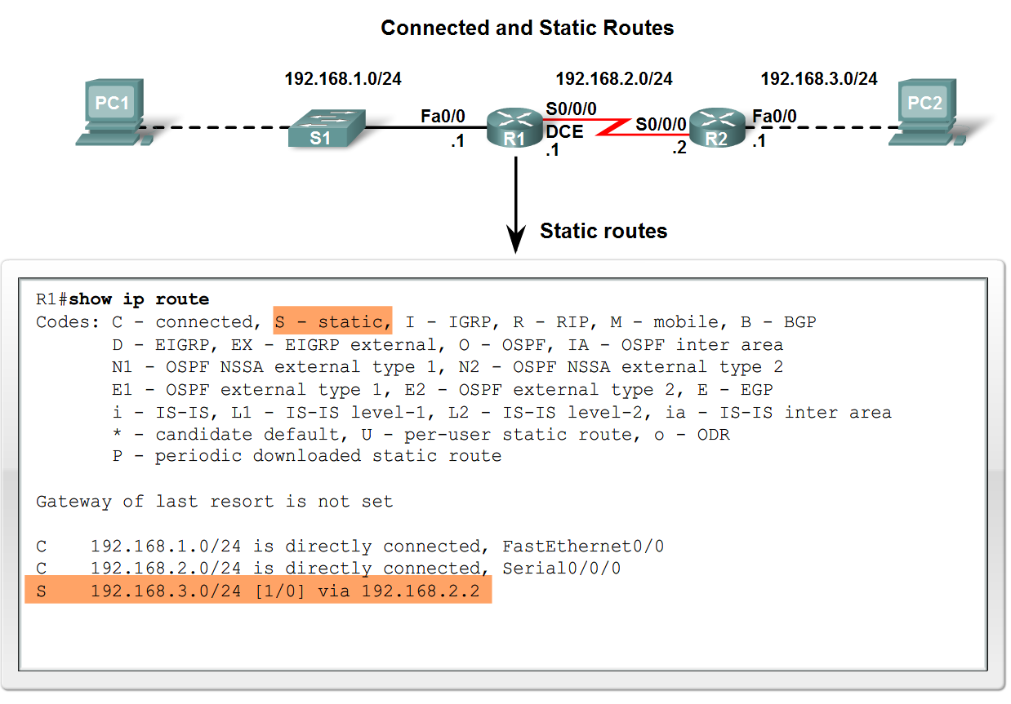
Routing Table Structure
Adding a connected network to the routing table
  -Router interfaces
    Each router interface is a member of a different network
    Activated using the no shutdown command
    In order for static and dynamic routes to exist in routing table you must have directly connected networks

Slide 31
Routing Table Structure
Static routes in the routing table
  -Includes: network address and subnet mask and IP address of next hop router or exit interface
  -Denoted with the code S in the routing table
  -Routing tables must contain directly connected networks used to connect remote networks before static or dynamic routing can be used
When to use static routes
  -When network only consists of a few routers
  -Network is connected to internet only through one ISP
  -Hub & spoke topology is used on a large network

Slide 32
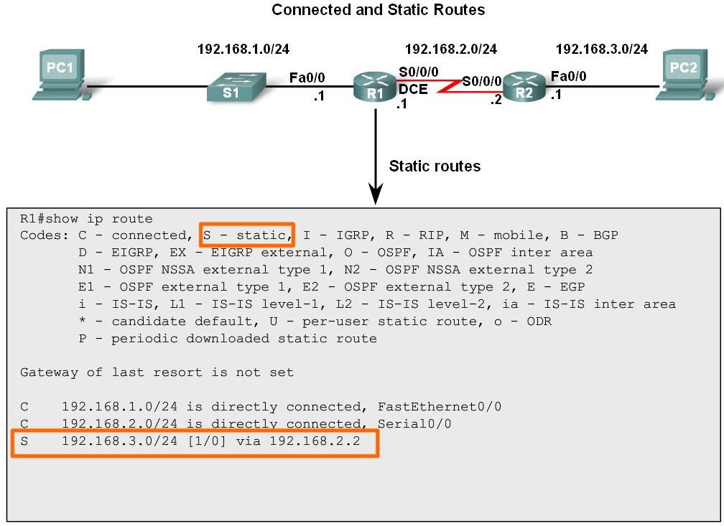
Routing Table Structure
Connected and Static routes

Slide 33
Routing Table Structure
Dynamic routing protocols
  -Used to add remote networks to a routing table
  -Are used to discover networks
  -Are used to update and maintain routing tables
Automatic network discovery
  -Routers are able discover new networks by sharing routing table information

Slide 34
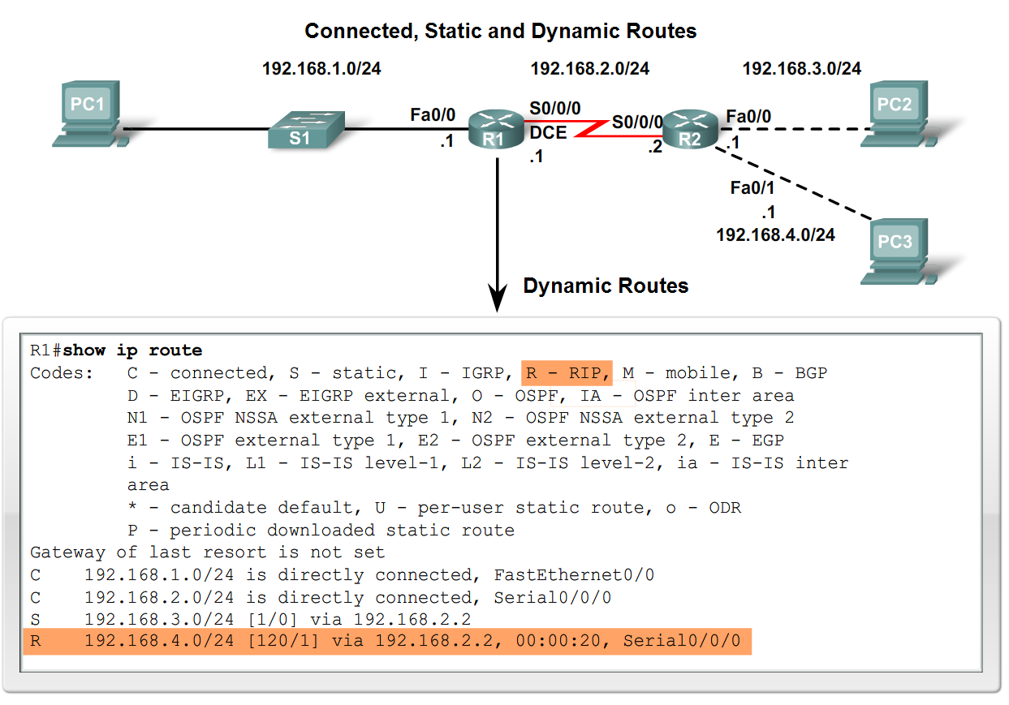
Routing Table Structure
Maintaining routing tables
  -Dynamic routing protocols are used to share routing information with other router & to maintain and up date their own routing table.
IP routing protocols. Example of routing protocols include:
  -RIP
  -IGRP
  -EIGRP
  -OSPF

Slide 35
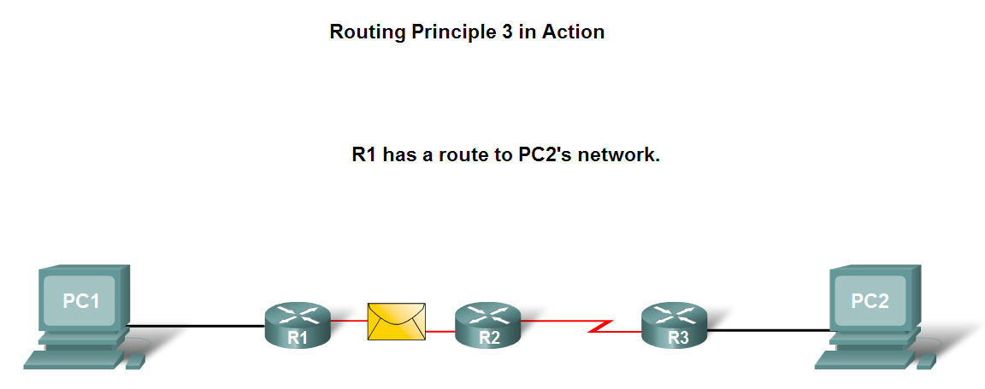
Routing Table Structure
Routing Table Principles
  -3 principles regarding routing tables:
    Every router makes its decisions alone, based on the information it has in its routing table.
    Different routing table may contain different information
    A routing table can tell how to get to a destination but not how to get back

Slide 36
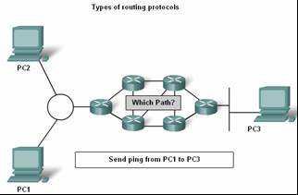
Routing Table Structure
Effects of the 3 Routing Table Principles
    -Packets are forwarded through the network from one router to another, on a hop by hop basis.
    -Packets can take path “X” to a destination but return via path “Y” (Asymmetric routing).

Slide 37
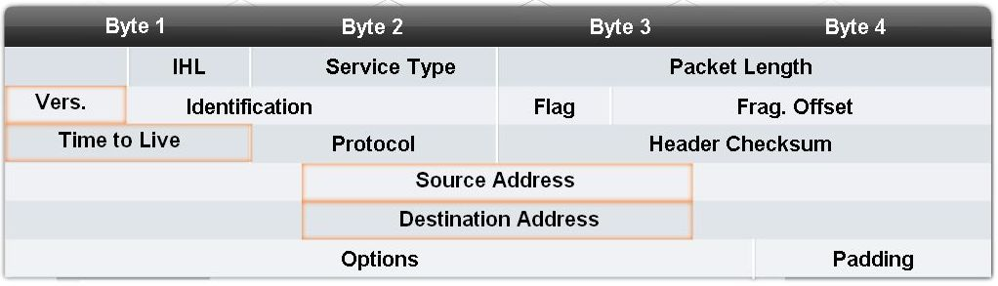
Router Paths and Packet Switching
Internet Protocol (IP) packet format contains fields that provide information about the packet and the sending and receiving hosts
Fields that are importance for CCNA students:
  -Destination IP address
  -Source IP address
  -Version & TTL
  -IP header length
  -Precedence & type of service
  -Packet length

Slide 38
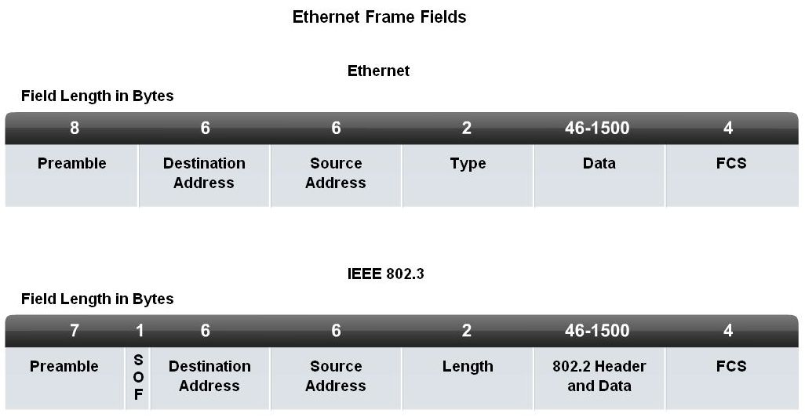
Router Paths and Packet Switching
MAC Layer Frame Format
MAC Frames are also divided into fields. They include:
  -Preamble
  -Start of frame delimiter
  -Destination MAC address
  -Source MAC address
  -Type/length
  -Data and pad
  -Frame check sequence

Slide 39
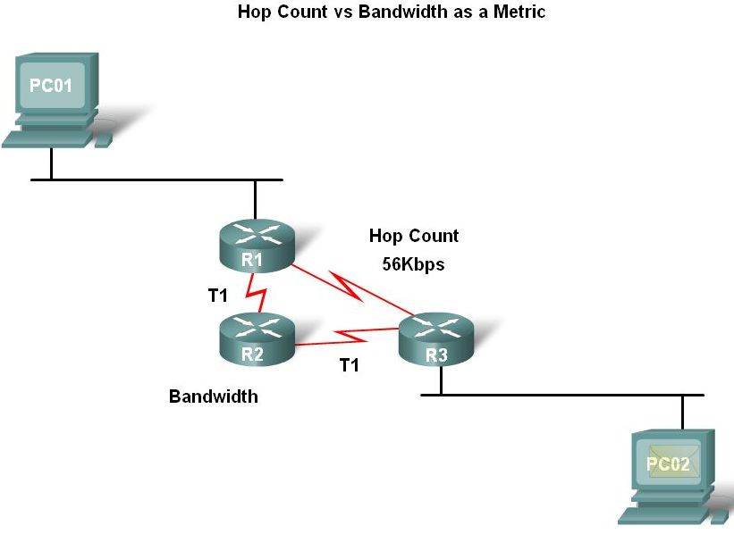
Router Paths and Packet Switching
A Metric is a numerical value used by routing protocols help determine the best path to a destination
  The smaller the metric value the better the path
2 types of metrics used by routing protocols are:
  -Hop count - this is the number of routers a packet must travel through to get to its destination
  -Bandwidth - this is the “speed” of a link also known as the data capacity of a link

Slide 40
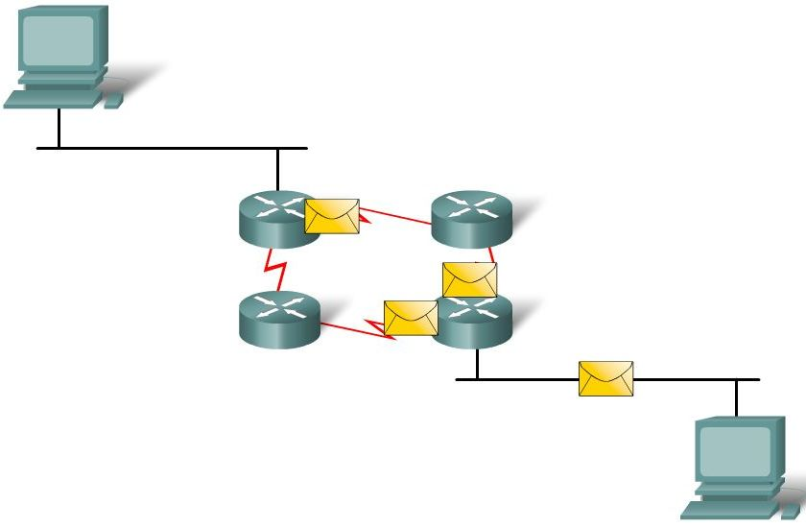
Router Paths and Packet Switching
Equal cost metric is a condition where a router has multiple paths to the same destination that all have the same metric
To solve this dilemma, a router will use Equal Cost Load Balancing. This means the router sends packets over the multiple exit interfaces listed in the routing table.

Slide 41
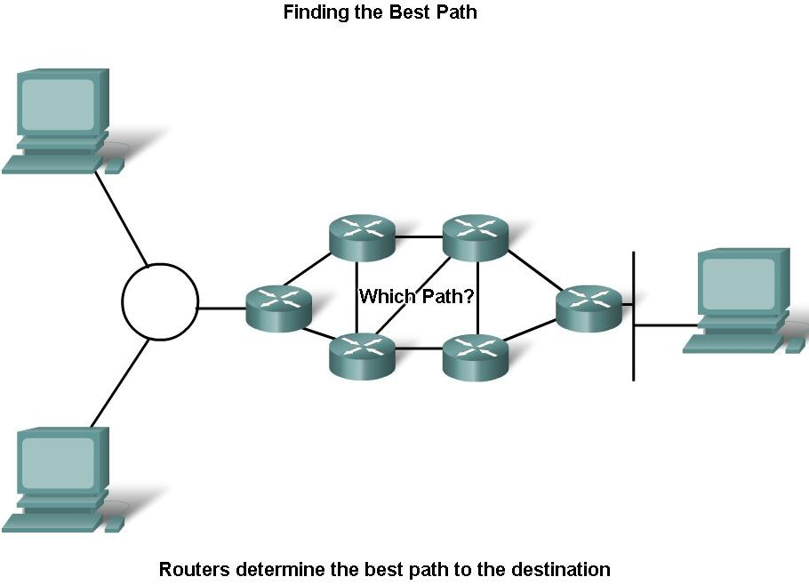
Router Paths and Packet Switching
Path determination is a process used by a router to pick the best path to a destination
One of 3 path determinations results from searching for the best path
  Directly connected network
  Remote network
  No route determined

Slide 42
Router Paths and Packet Switching
Switching Function of Router is the process used by a router to switch a packet from an incoming interface to an outgoing interface on the same router.
  -A packet received by a router will do the following:
        Strips off layer 2 headers.
        Examines destination IP address located in Layer 3 header to find best route to destination.
        Re-encapsulates layer 3 packet into layer 2 frame.
        Forwards frame out exit interface.

Slide 43
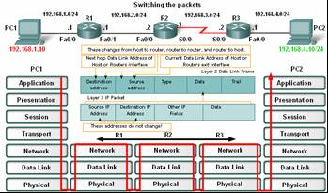
Router Paths and Packet Switching
As a packet travels from one networking device to another
  -The Source and Destination IP addresses NEVER change
  -The Source & Destination MAC addresses CHANGE as packet is forwarded from one router to the next.
  -TTL field decrement by one until a value of zero is reached at which point router discards packet (prevents packets from endlessly traversing the network)

Slide 44
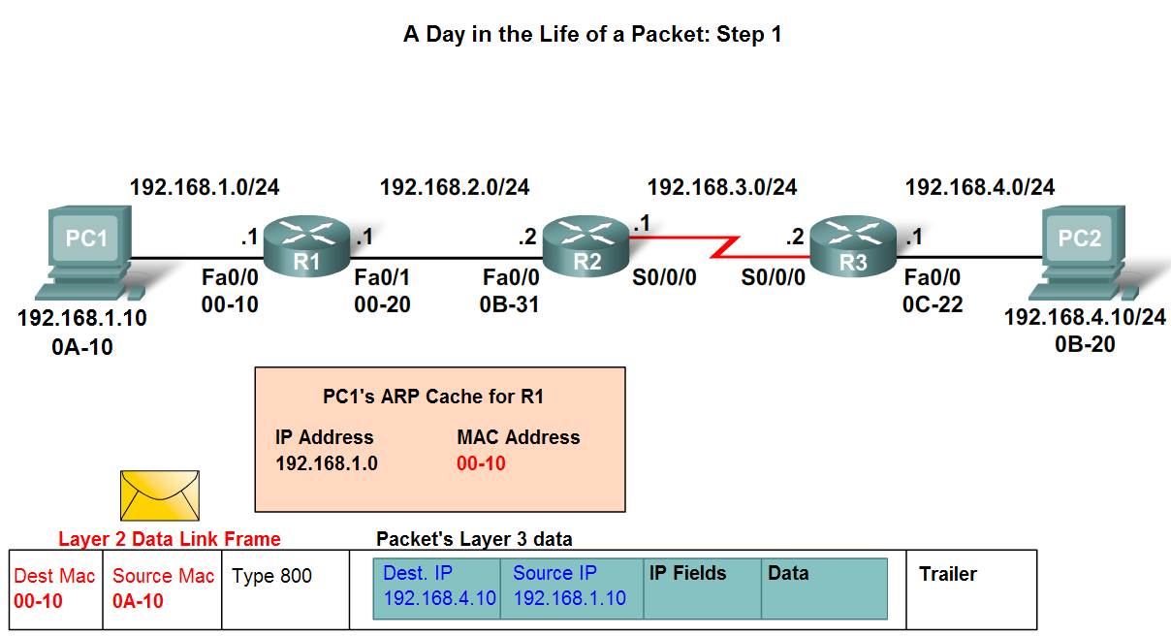
Router Paths and Packet Switching
Path determination and switching function details. PC1 Wants to send something to PC 2 here is part of what happens
  Step 1 - PC1 encapsulates packet into a frame. Frame contains R1’s destination MAC address

Slide 45
Router Paths and Packet Switching
  Step 2 - R1 receives Ethernet frame.
    R1 sees that destination MAC address matches its own MAC.
    R1 then strips off Ethernet frame.
    R1 Examines destination IP.
    R1 consults routing table looking for destination IP.
    After finding destination IP in routing table, R1 now looks up next hop IP address.
    R1 re-encapsulates IP packet with a new Ethernet frame.
    R1 forwards Ethernet packet out Fa0/1 interface.

Slide 46
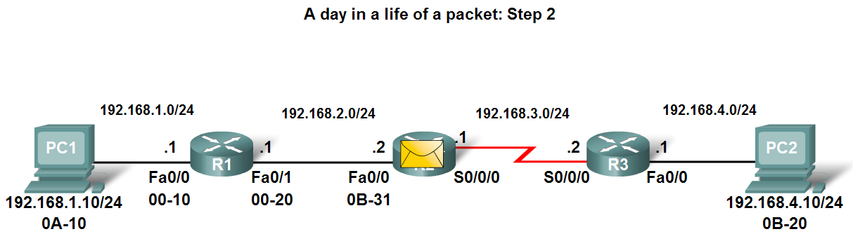
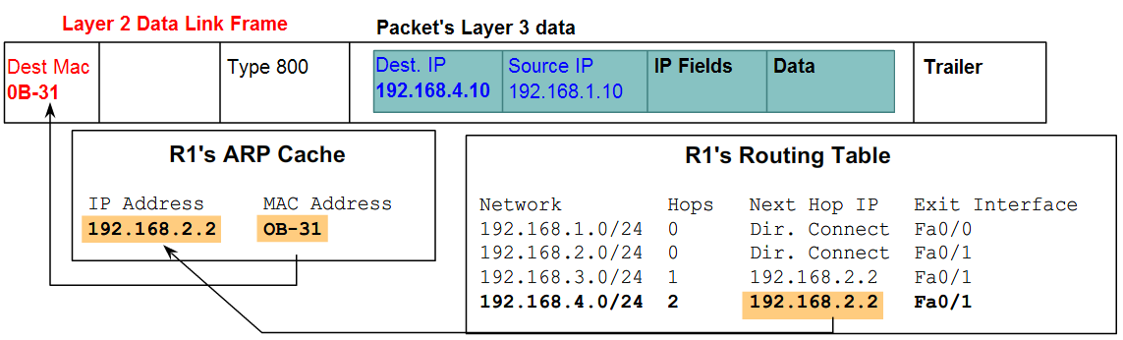
Router Paths and Packet Switching

Slide 47
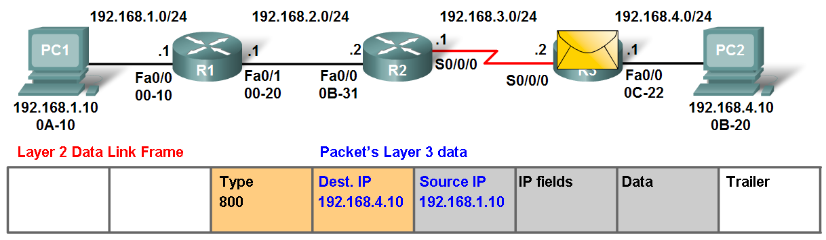
Router Paths and Packet Switching
Path determination and switching function details. PC1 Wants to send something to PC 2 here is part of what happens
  Step 3 - Packet arrives at R2
    R2 receives Ethernet frame
    R2 sees that destination MAC address matches its own MAC
    R2 then strips off Ethernet frame
    R2 Examines destination IP
    R2 consults routing table looking for destination IP
    After finding destination IP in routing table, R2 now looks up next hop IP address
    R2 re-encapsulates IP packet with a new data link frame
    R2 forwards Ethernet packet out S0/0 interface

Slide 48
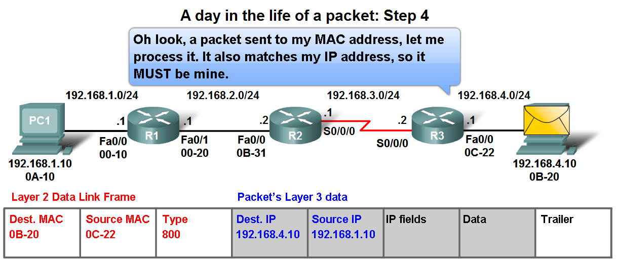
Router Paths and Packet Switching
Path determination and switching function details. PC1 Wants to send something to PC 2 here is part of what happens
  Step 4 - Packet arrives at R3
    R3 receives PPP frame
    R3 then strips off PPP frame
    R3 Examines destination IP
    R3 consults routing table looking for destination IP
    After finding destination IP in routing table, R3 is directly connected to destination via its fast Ethernet interface
    R3 re-encapsulates IP packet with a new Ethernet frame
    R3 forwards Ethernet packet out Fa0/0 interface
  Step 5 - IP packet arrives at PC2. Frame is decapsulated & processed by upper layer protocols.

Slide 49
Summary
Routers are computers that specialize in sending data over a network.
Routers are composed of:
  -Hardware i.e. CPU, Memory, System bus, Interfaces
  -Software used to direct the routing process
    IOS
    Configuration file
Routers need to be configured. Basic configuration consists of:
  -Router name
  -Router banner
  -Password(s)
  -Interface configurations i.e. IP address and subnet mask
Routing tables contain the following information
  -Directly connected networks
  -Remotely connected networks
  -Network addresses and subnet masks
  -IP address of next hop address

Slide 50
Summary
Routers determine a packets path to its destination by doing the following
  Receiving an encapsulated frame & examining destination MAC address.
  If the MAC address matches then Frame is de-encapsulated so that router can examine the destination IP address.
  If destination IP address is in routing table or there is a static route then Router determines next hop IP address. Router will re-encapsulate packet with appropriate layer 2 frame and send it out to next destination.
  Process continues until packet reaches destination.
  Note - only the MAC addresses will change the source and destination IP addresses do not change.

